Slide 2
What's New in C# 3.0
Session Code: DEV210
or: “Is C# the next Ruby?”
Paul Stovell MVP: Client Application Development
Senior Developer
Readify

Slide 3
Notes (hidden)
Some speakers at Microsoft like to use this slide for hidden “notes slides”.
Delete it if you don’t want to use it.
NEXT: <next slide title>

Slide 4
Presentation Outline (hidden slide):
Speaker instructions: Complete this slide to assist your SME (subject matter expert) in evaluating your presentation flow, topic coverage, demo integration and alignment of content to your session description and level.
Title: Reactive Programming
Technical Level: 300
Intended Audience: Rich client developers
Objectives (what do you want the audience to take away from this session):
1.Data Binding in Windows Forms/WPF is very powerful
2.Reactive programming can reduce code and make programs simpler
3.LINQ is very extensible
Presentation Outline (including demos):

Slide 5
New in C# 3.0
“var” keyword
Extension methods
Automatic Properties
Object Initialisers
Anonymous types
Lambda expressions
Generic type parameter inference
LINQ
Partial methods

Slide 6

Vote for Me

Slide 7


PowerShell is for Communists

Slide 8
Q & A

Slide 9




Resources
www.microsoft.com/teched
Tech·Talks Tech·Ed Bloggers
Live Simulcasts Virtual Labs
http://microsoft.com/technet
Evaluation licenses, pre-released products, and MORE!
http://microsoft.com/msdn
Developer’s Kit, Licenses, and MORE!

Slide 10
Related Content
Breakout Sessions
DEV 475 – F#: For the Love of Programming
Hands-on-Labs
WIN01-HOL: Using Data Binding in Windows Presentation Foundation 3.5

Slide 11
Track Resources
My Blog: www.paulstovell.com

Slide 12
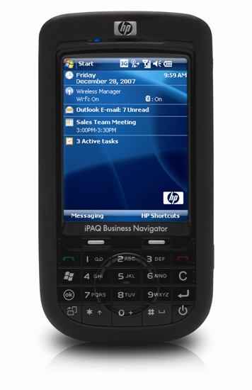


win!
Complete an evaluation on CommNet and enter to

Slide 13

© 2008 Microsoft Corporation. All rights reserved. Microsoft, Windows, Windows Vista and other product names are or may be registered trademarks and/or trademarks in the U.S. and/or other countries.
The information herein is for informational purposes only and represents the current view of Microsoft Corporation as of the date of this presentation. Because Microsoft must respond to changing market conditions, it should not be interpreted to be a commitment on the part of Microsoft, and Microsoft cannot guarantee the accuracy of any information provided after the date of this presentation. MICROSOFT MAKES NO WARRANTIES, EXPRESS, IMPLIED OR STATUTORY, AS TO THE INFORMATION IN THIS PRESENTATION.

